Slide 1
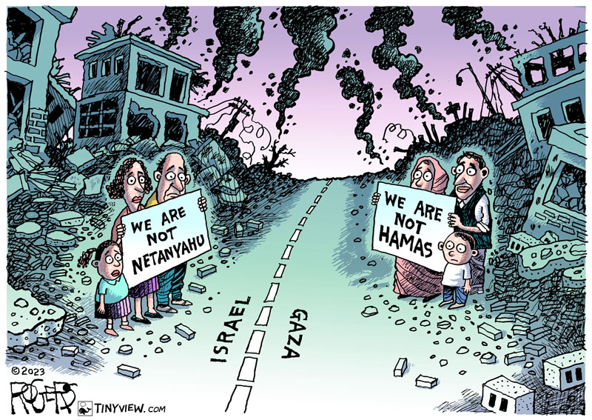
Forum on Gaza War

Slide 2
Questions:
How to respond to war crimes without committing war crimes?
How might a theology of peace offer guidance for peacebuilding?

Slide 3
Just War Theory
(International Laws of Armed Combat)
Jus ad Bellum
Just cause
Right authority
Right intention
Reasonable hope of success
Proportionality
Last Resort
Jus in Bello
Non-combatant immunity
Proportionality (minimum use of force)

Slide 4
International Laws of Armed Combat
Legally Justifiable War.
Protect their populations
Responsibility to protect.
Just Conduct in War
Non-combatant immunity
Proportionality (minimum use of force)

Slide 5
Just Cause:
To destroy Hamas’s governing ideology
Question: What comes next?
Just Conduct:
Very Complex: IDF treats non-combatant Palestinians as if they were non-combatant Israelis.
Urban warfare is very bloody.
Can not justify, but can they be excused?

Slide 6
My Statement:
The destruction of Hamas’s governing ideology is a justifiable war objective. Achieving this objective will require a complex, multi-dimensional strategy that cannot be furthered by reducing Gaza to rubble. The core of Hamas’s governing ideology is the establishment of an Islamic state over the entire region. According to its 1988 Charter: “There is no solution for the Palestinian question except through Jihad. Initiatives, proposals, and international conferences are all a waste of time and vain endeavors.” The only way to ensure Hamas’s defeat as an ideology is to grant Palestinians full citizenship in either a Palestinian state or Israel.
We pray that, if the IDF launches a campaign of urban warfare, it will conduct its operations in accordance with the principles of non-combatant immunity and proportionality. Non-combatant immunity means that only those directly involved in the war effort can be targeted. It does not differentiate between Palestinian and Israeli non-combatants and, therefore, obligates the IDF to treat Palestinian non-combatants as if they were Israelis. Proportionality means that the IDF uses minimal force to achieve its objectives and refrains from “creating a severe humanitarian crisis” as a stated war objective. Urban warfare is bloody and difficult, and these principles will be violated. Recognizing this, we encourage the IDF to explain publicly why such violations were either necessary or unavoidable. We do not believe that Hamas respects non-combatant immunity and proportionality, but that Hamas’s actions do not lessen the IDF’s responsibility to act with moral constraint.
We encourage the United States to initiate a new round of diplomatic efforts focused on attaining citizenship for Palestinians. For years, efforts to negotiate a resolution of the Israeli-Palestinian conflict have failed. A focus on attaining citizenship for Palestinians cuts through these deadlocks by placing the decision for one state or two states at the forefront. Either choice presents severe risks for both Israelis and Palestinians that cannot be minimized. Nevertheless, refusing to address the question of Palestinian citizenship only ensures that future atrocity will occur.

Slide 7
A Theology of Peace
A commitment to non-violence is not an adequate theory of peace.
Matt: 5:43-45:
"You have heard that it was said, You must love your neighbor and hate your enemy (echthros) But I say to you, love your enemies and pray for those who harass you so that you will be acting as children of your Patron/Matron who is in heaven.”
(hatred vs. safety)

Slide 8
A theology of peace must say something serious about peace.
Peace is a relationship shaped by four themes:
  Sharing a future
  Demonstrating trustworthiness
  Accepting Loss
  Rectifying injustice
Peacebuilding is not about reaching agreement, but about making disagreement safe.
  Fostering dignity
  Safeguarding livelihoods
  Encouraging respect

Slide 9
What makes this theory of peace a theology of peace?
Agape
In a broken world filled with broken people, agape heals.
The political goal is reciprocal goodwill.
Agape is a goodwill that does not depend upon a reciprocal response. (Matthew 5: 43-45)

